Slide 1
HYDRAULICS & HYDRAULIC MACHINES

Slide 2
Unit 3: Impact of jet on flat vanes

Slide 3
Learning Outcome
In this unit, you will learn
Concept of Impulse momentum principle
Force exerted by jet on a stationary flat vane
Force exerted by jet on a moving flat vane
Force exerted by jet on a series of flat vanes on a wheel
Force exerted by jet on a hinged flat vane

Slide 4
Momentum Defined
p = m v
p = momentum vector
m = mass
v = velocity vector

Slide 5
Impulse Defined
Impulse is defined as the product force acting on an object and the time during which the force acts. The symbol for impulse is J. So, by definition:
J = F t

Slide 6
Impulse - Momentum Principle
The impulse due to all forces acting on an object (the net force) is equal to the change in momentum of the object:
F_{net} t = Δ p
We know the units on both sides of the equation are the same (last slide), but let’s prove the theorem formally:
F_{net} t = m a t = m (Δ v / t) t = m Δ v = Δ p

Slide 7
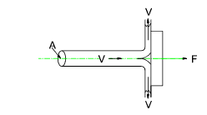
Direct impact of a jet on a stationary flat vane
F = waV ²/g

Slide 8
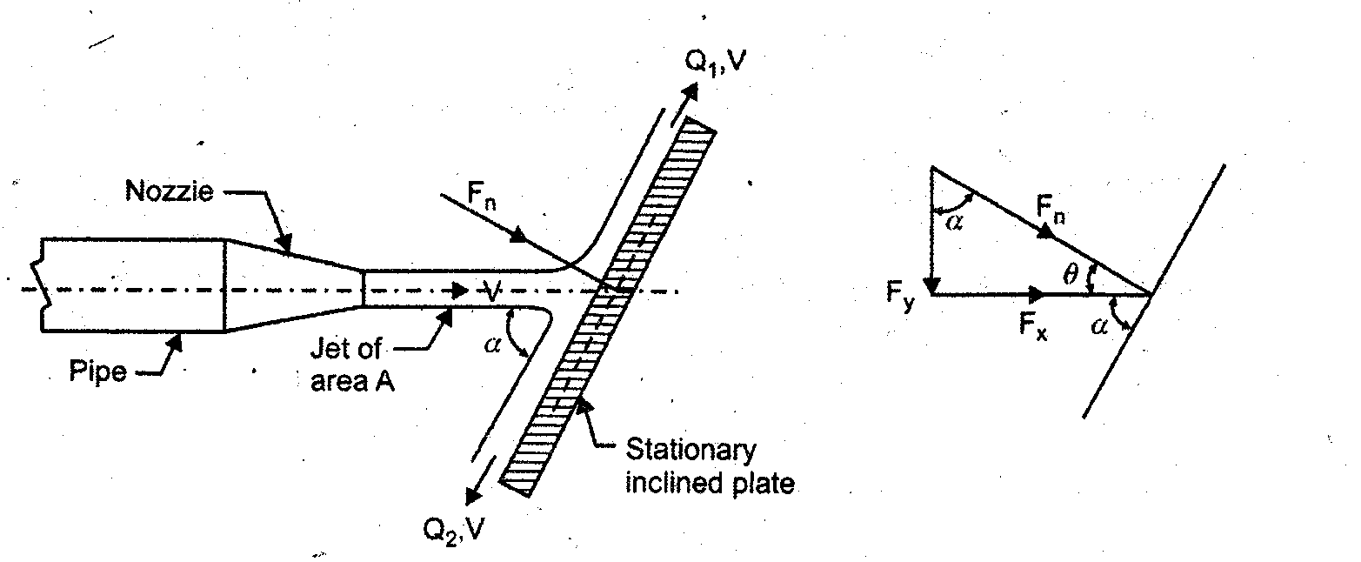
Oblique impact of a jet on a stationary flat vane
F_{n} = waV²/g sinθ
F_{x} = waV²/g sin²θ
F_{y} = waV²/g sinθ cosθ

Slide 9
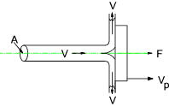
Direct impact of a jet on a moving flat vane
F = wa(V – V_{p})²/g
y

Slide 10
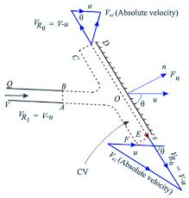
Oblique impact of a jet on a moving flat vane
F_{n} = wa(V-u) ²/g sinθ
F_{x} = wa(V – u)²/g sin²θ
F_{y} = wa(V – u)²/g sinθ cosθ
2

Slide 11
Impact of a jet on a series of flat vanes mounted on a wheel
F = w/g V(V – u)
_{ᶯ} = 2u (V - u)/V²
ᶯ_{max = 0.5}

Slide 12
Impact of a jet on a hinged flat vane

Slide 13
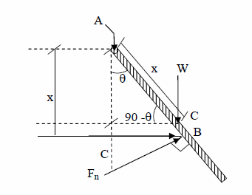
Impact of a jet on a hinged flat vane

Slide 14
Problems
1.A jet of water 50 mm diameter strikes a flat plate held normal to the direction of jet. Estimate the force exerted and work done by the jet if:
a. The plate is stationary
b. The plate is moving with a velocity of 1 m/s away from the jet along the line of jet.
c. When the plate is moving with a velocity of 1 m/s towards the jet along the same line.
The discharge through the nozzle is 76 lps.
2. A jet of data 75 mm diameter has a velocity of 30 m/s. It strikes a flat plate
inclined at 45o to the axis of jet. Find the force on the plate when:
a. The plate is stationary
b. The plate is moving with a velocity of 15 m/s along and away from the jet.
Also find power and efficiency in case (b)
3. A square plate weighing 140 N has an edge of 300 mm. The thickness of the
plate is uniform. It is hung so that it can swing freely about the upper horizontal edge.
A horizontal jet of 20 mm diameter having 15 m/s velocity impinges on the plate.
The centre line of jet is 200 mm below. The centre line of jet is 200 mm below the
upper edge of plate. Find what force must be applied at the lower edge of plate in
order to keep it vertical.

Slide 15
Questions
Explain the concept of Impulse momentum principle
Derive an expression for the force exerted by jet on a stationary flat vane
Derive an expression for force exerted by jet on a moving flat vane
Derive an expression for force exerted by jet on a series of flat vanes on a wheel
Derive an expression for the angle of inclination of a hinged flat vane due to the force exerted by a jet of water on it

